Slide 1


INSTITUTE FOR ADVANCED COMPUTING AND SOFTWARE DEVELOPMENT AKURDI, PUNE
Documentation On
“Ghar ka dabba”
PG-DAC SEPT 2022
Submitted By:
Group No: 71
Roll No. Name:
229153 Shubham gudekar
229190 Rishal mehta
Mrs. Manjiri deshpande Mrs. Rohit puranik
Project guide Centre Coordinator

Slide 2
Introduction
Purpose
The Online tiffin service 'Ghar Ka Dabba' website is intended to provide complete solution for Vendors, Customer as well as Internal users (Staff) as a single Gateway using internet. Vendors could be anyone who want to setup their tiffin service center but don’t have platform for the same specially housewife’s who wish have a source of side income. It will enable vendors to provide tiffin service online, consumers to browse through all the available tiffin service and order tiffin without physically visiting the tiffin service center.

Slide 3
Project Background
In the current competitive world, many youths travel to different unknown locations for their basic education or jobs. The main problem they face is the food they get, and they crave for homemade food, but it is difficult to find it. On the other hand, some housewives wish to work and earn money to gain financial independence. It is difficult for these ladies to reach customers and market their products.

Slide 4
Goals of the project
The main objective of this project is to give a common platform for the customers and service provider. This system will help consumers from various places to communicate with various providers (tiffin service providers) and ease their searching efforts. The main interest of the Project is to create a central service system that will act as a bridge between providers and consumers.

Slide 5
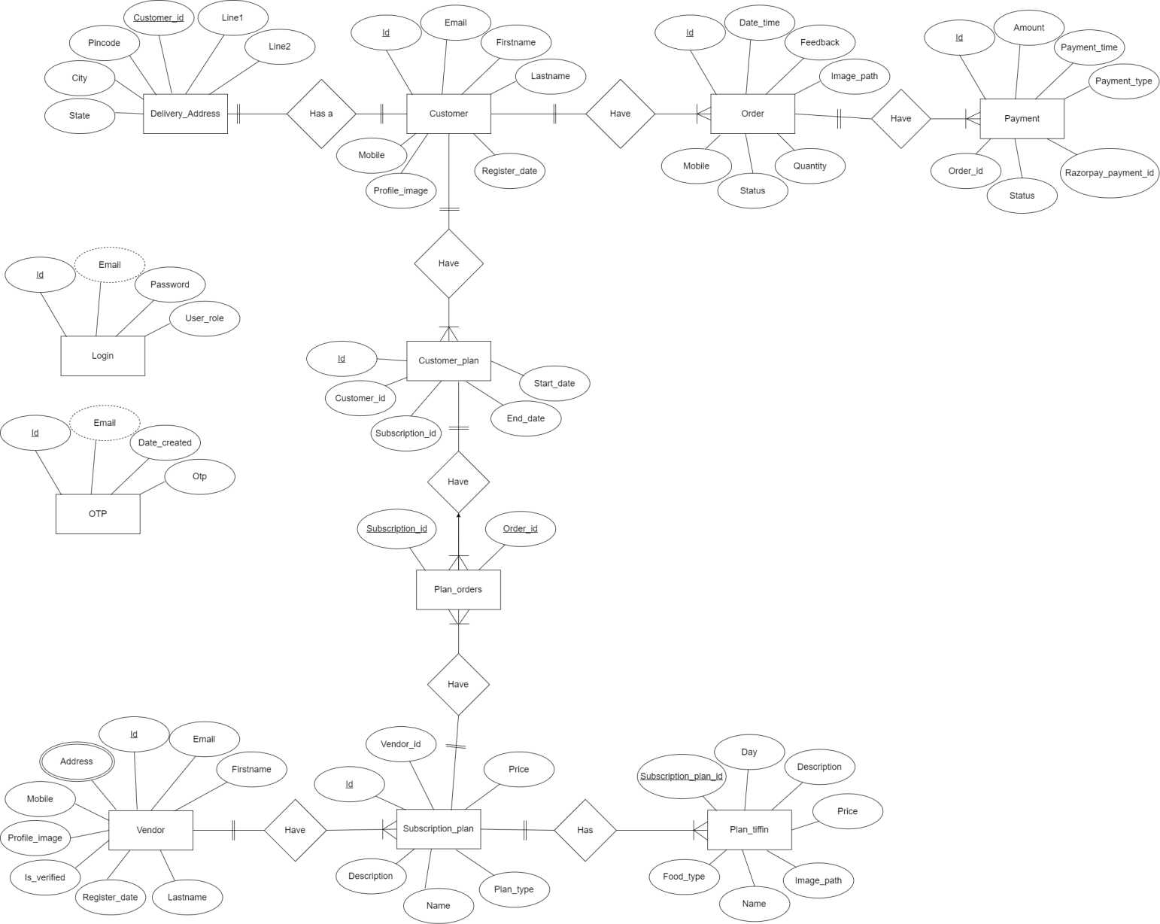
System diagrams E-R diagram

Slide 6
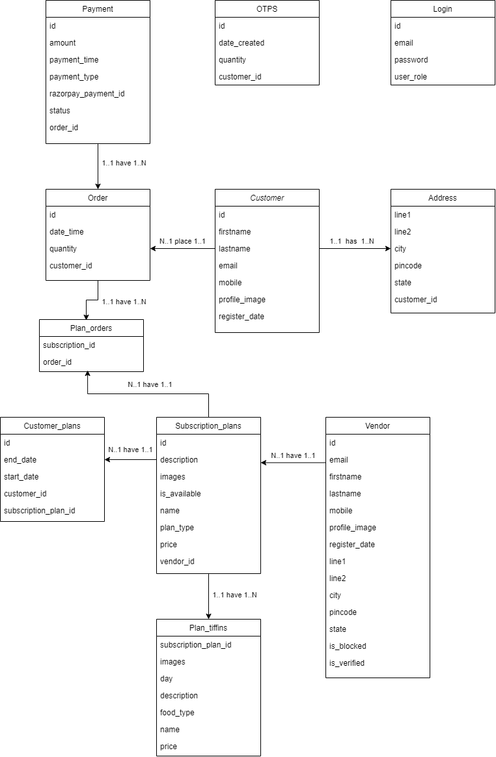
Class diagram

Slide 7
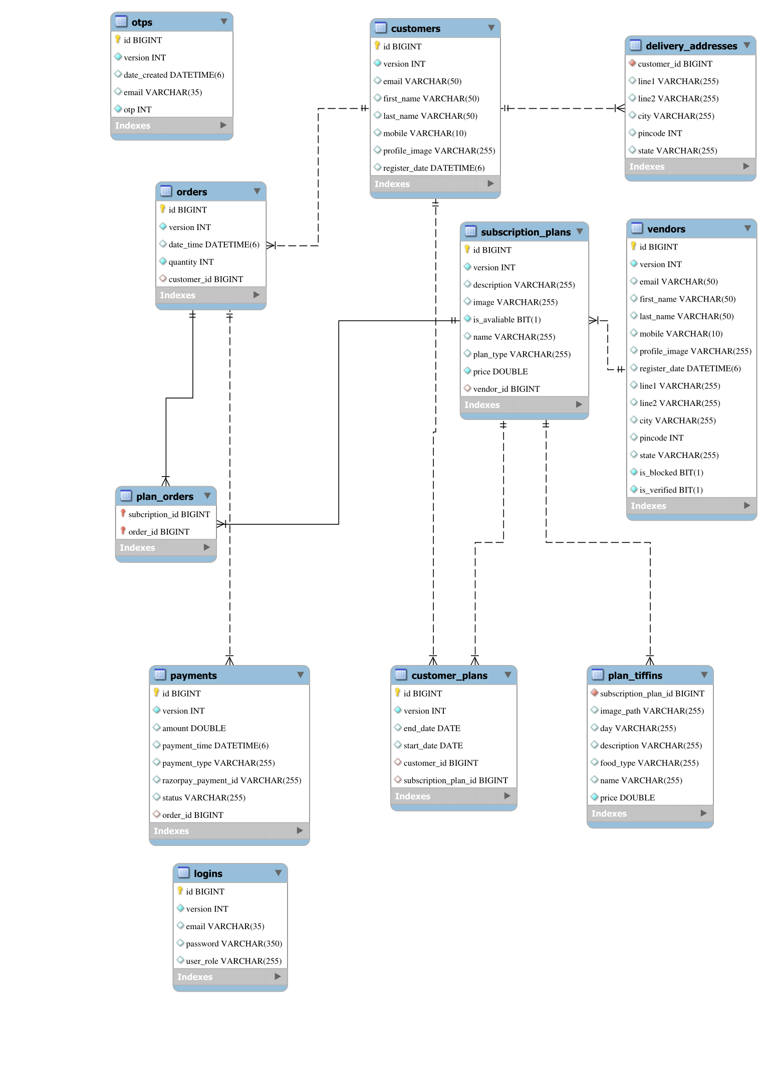
E-R diagram(My sql)

Slide 8
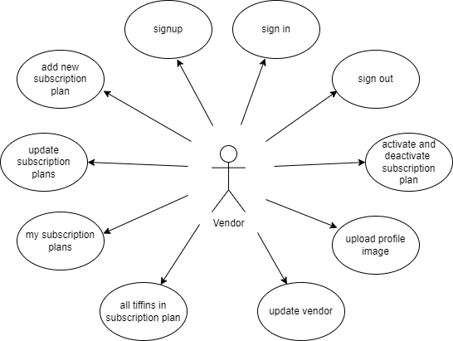
Vendor use case diagram

Slide 9
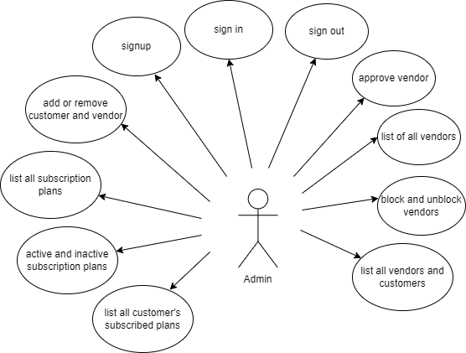
Admin use case diagram

Slide 10
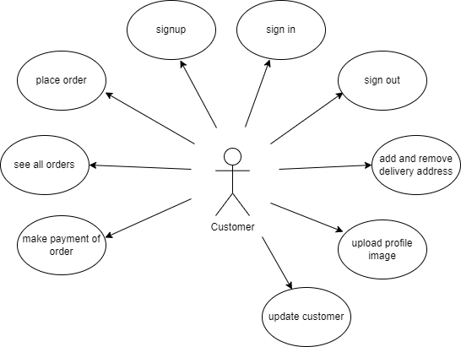
Customer use case diagram

Slide 11
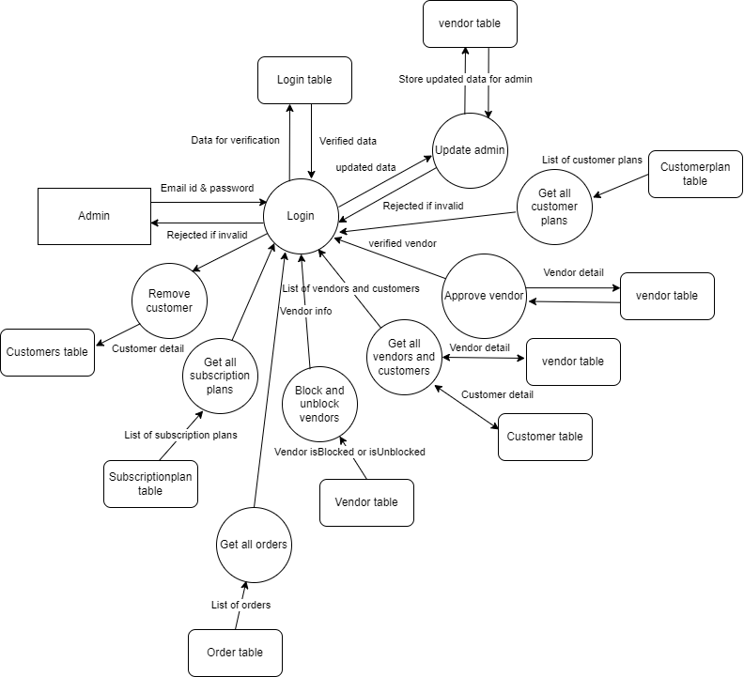
Level 1 DFD Admin diagram

Slide 12
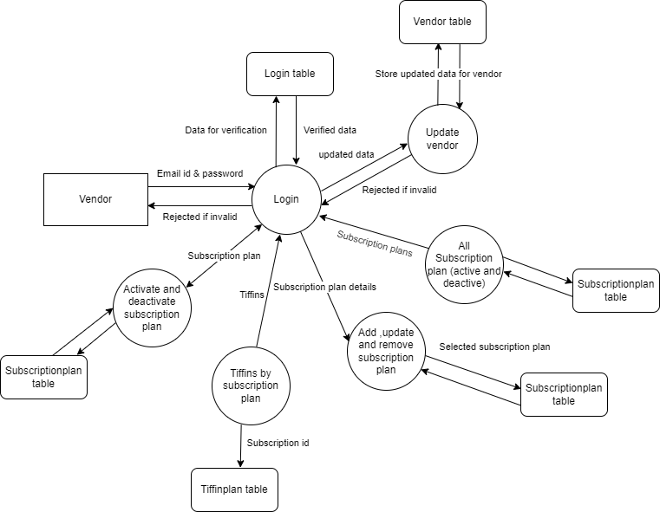
Level 1 DFD Vendor diagram

Slide 13
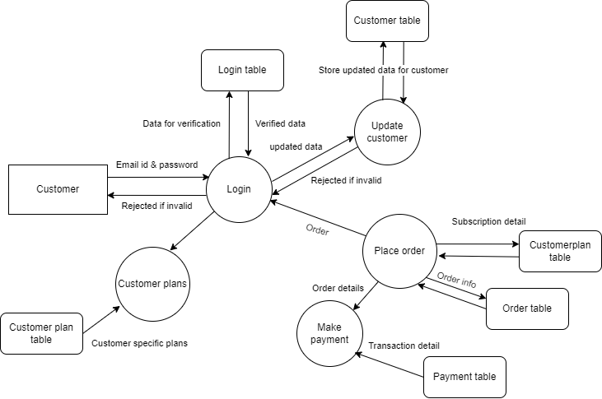
Level 1 DFD Customer diagram

Slide 14
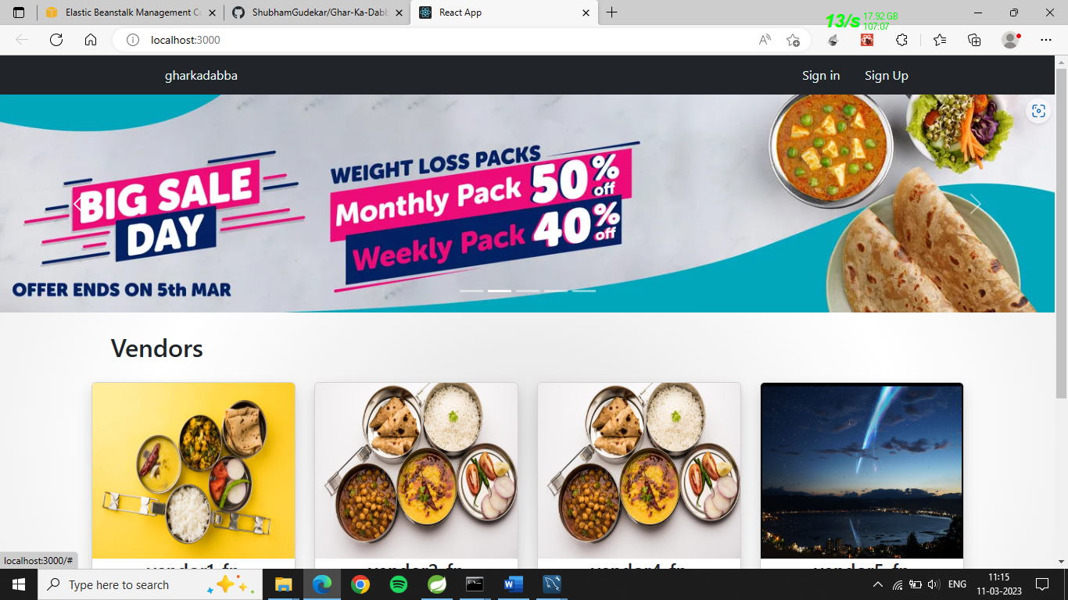
Screenshots
Home

Slide 15
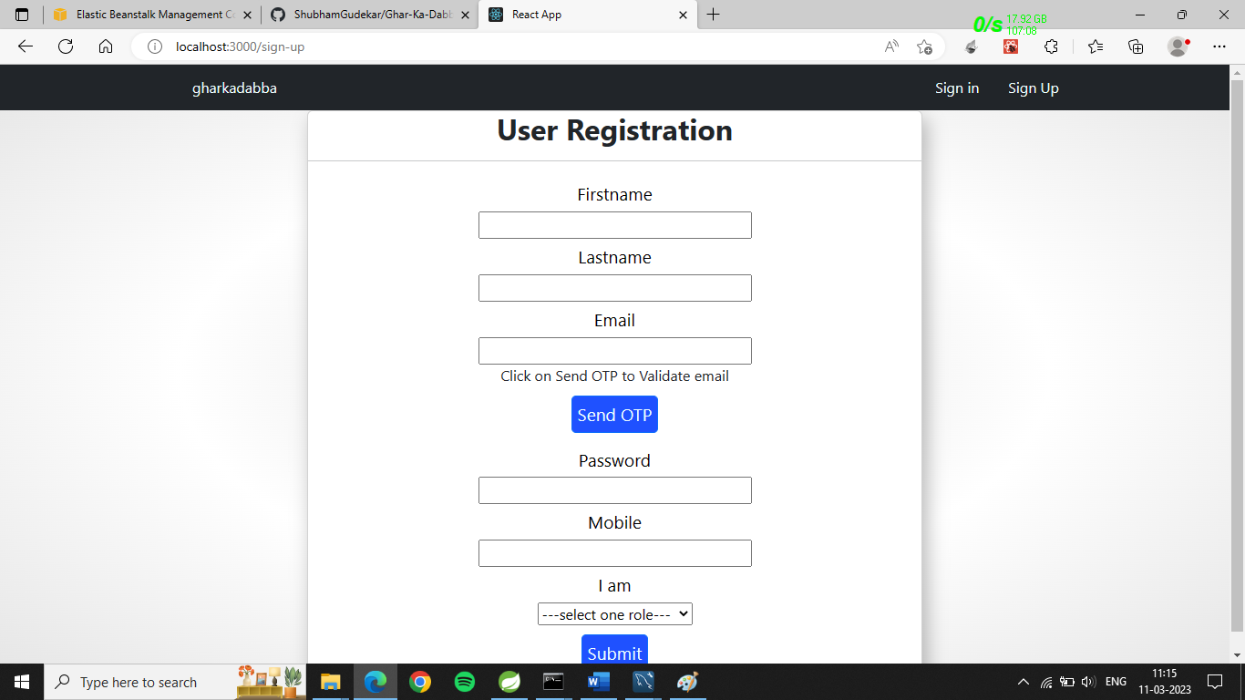
Sign up

Slide 16
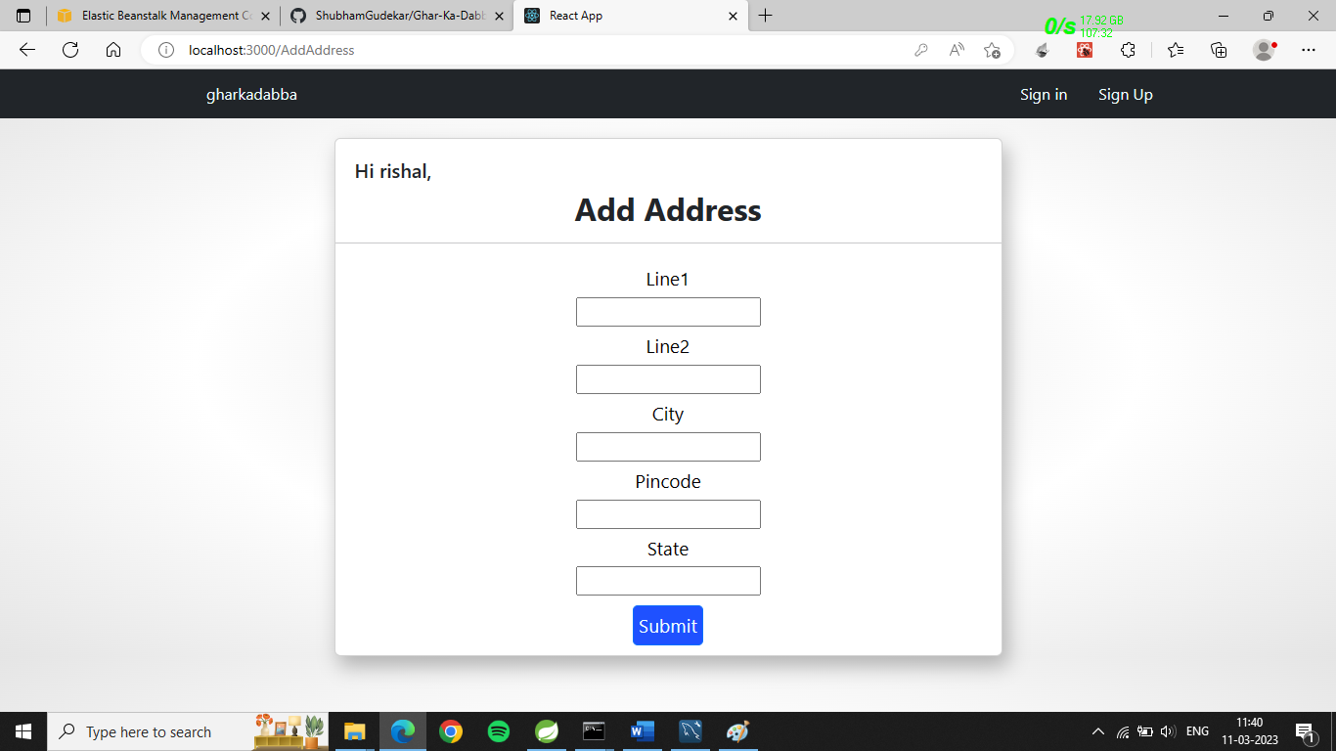
Sign up address

Slide 17
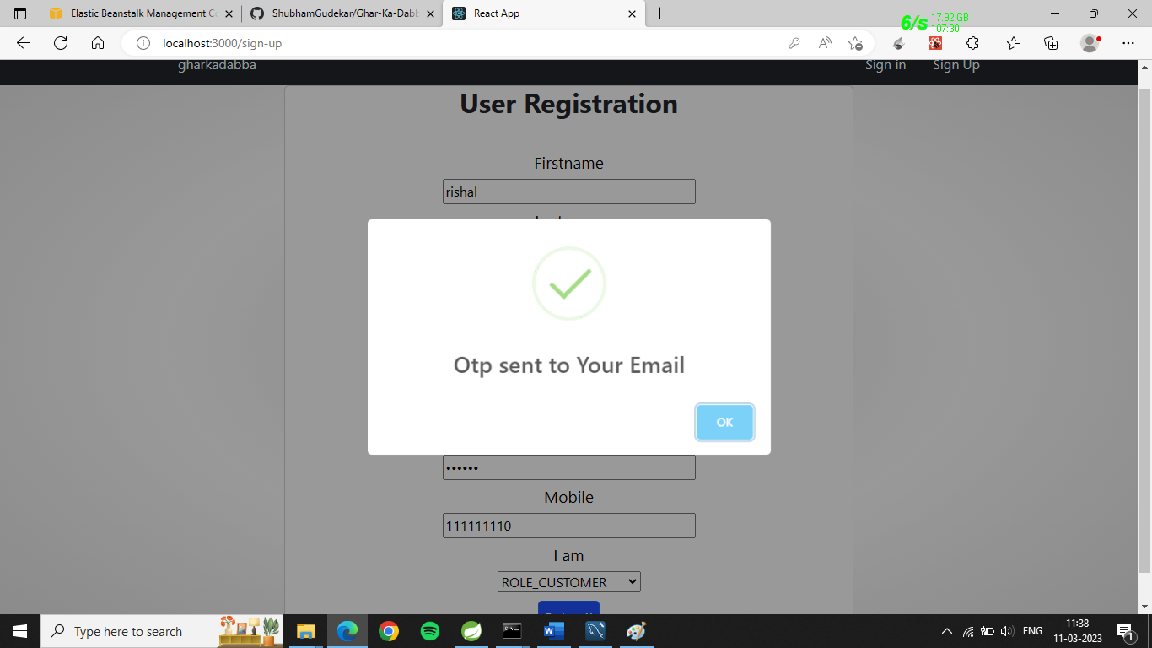
Sign up verify email id

Slide 18
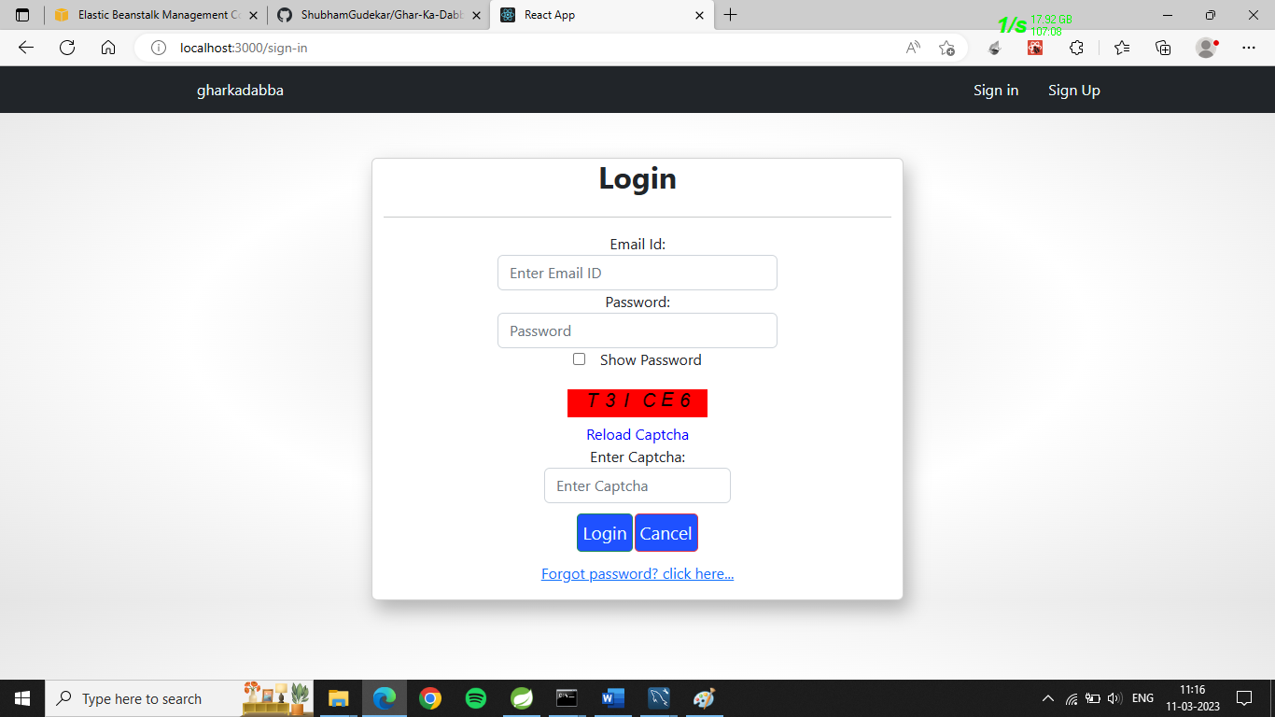
Sign in

Slide 19
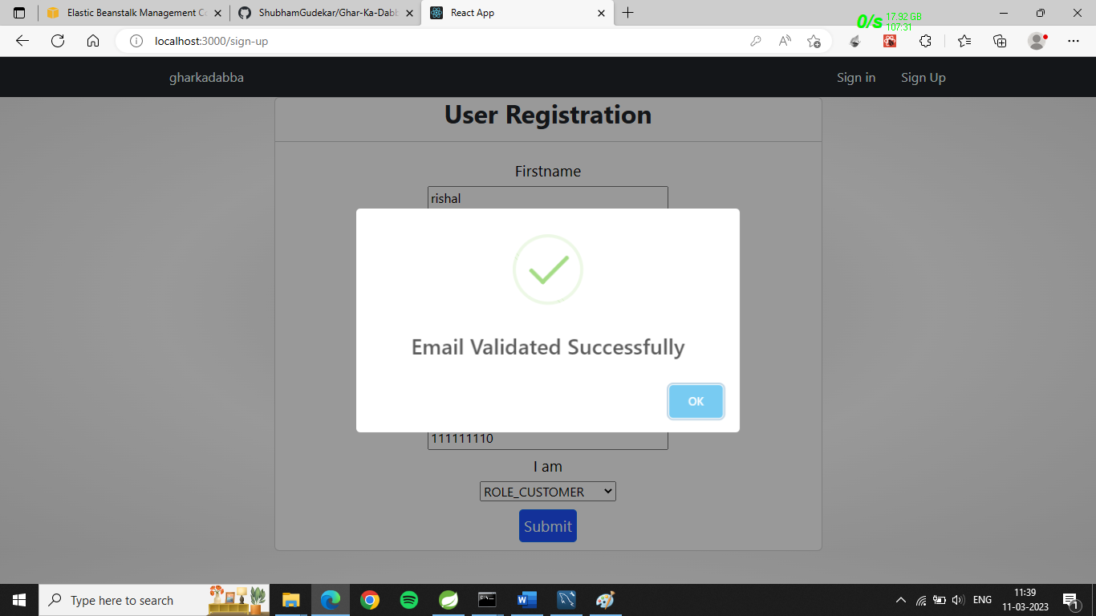
Sign in email validation

Slide 20
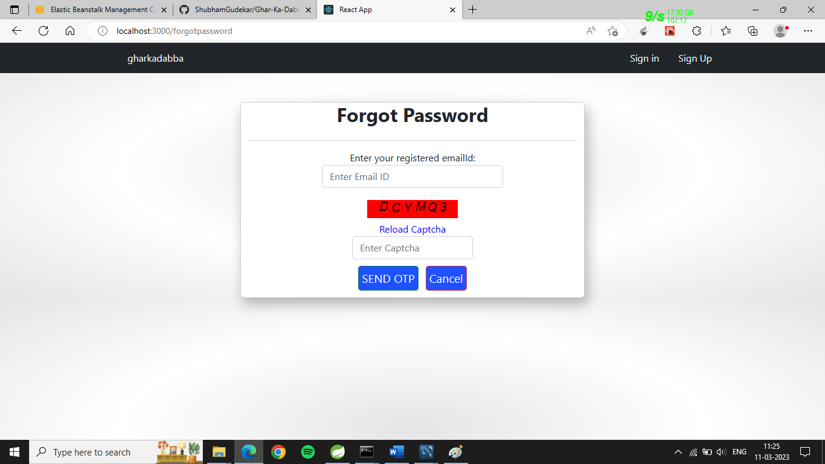
Forgot password page

Slide 21
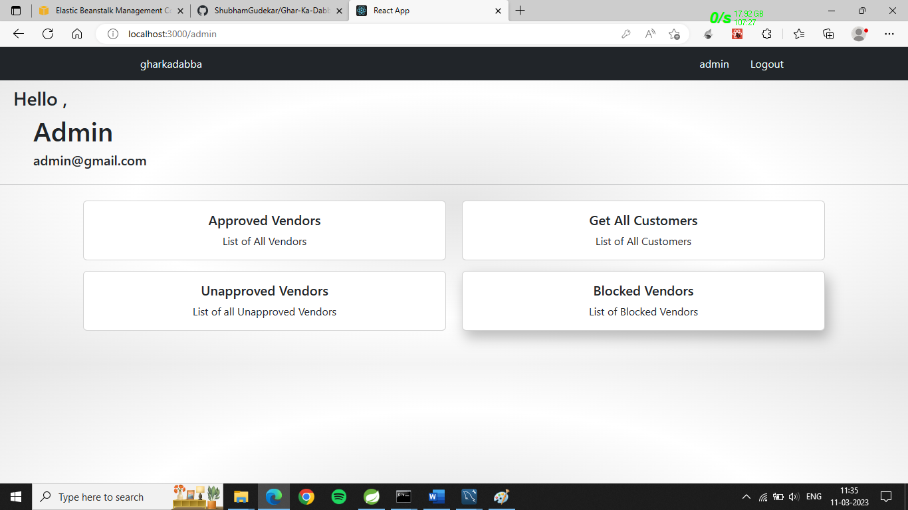
Admin home page

Slide 22
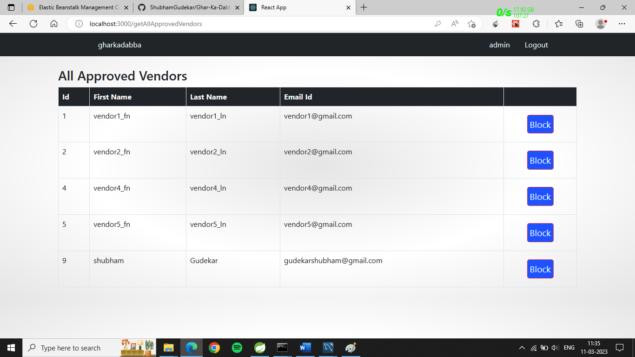
All approved vendors on admin page

Slide 23
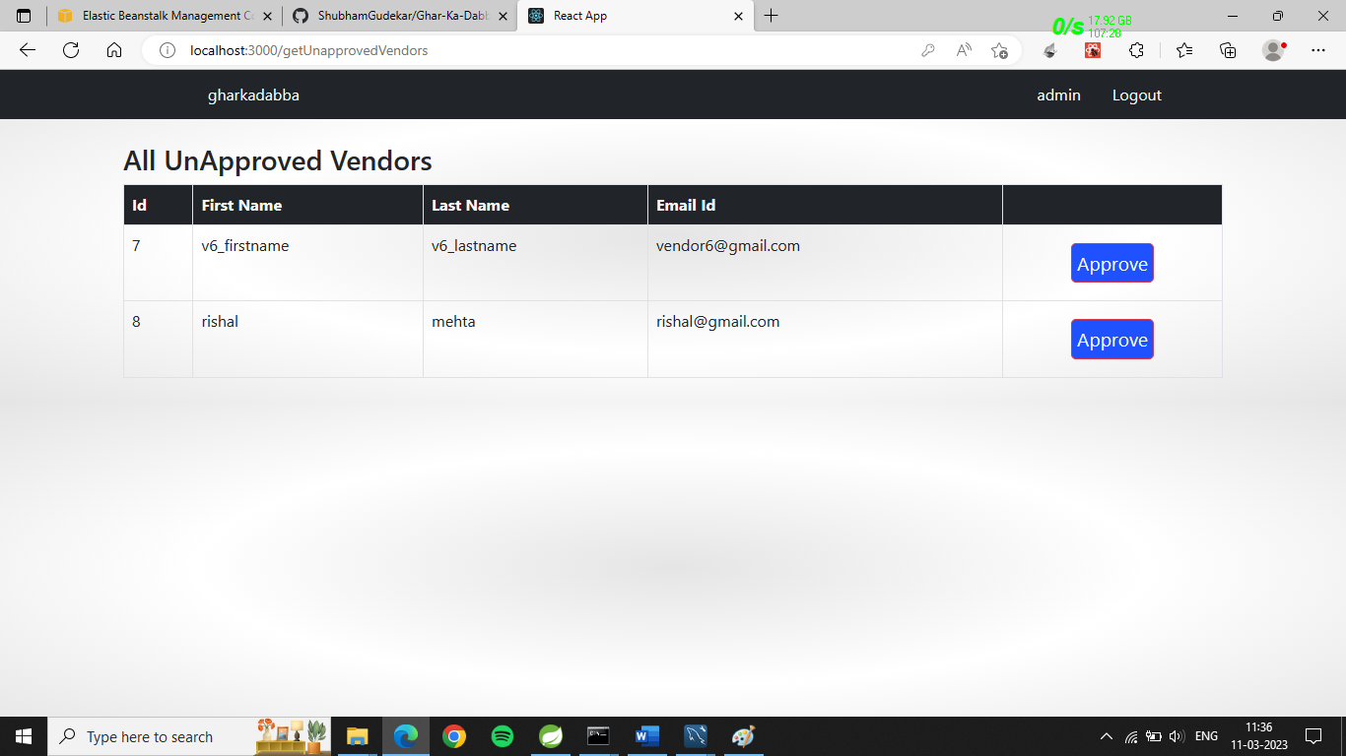
All unapproved vendors on admin page

Slide 24
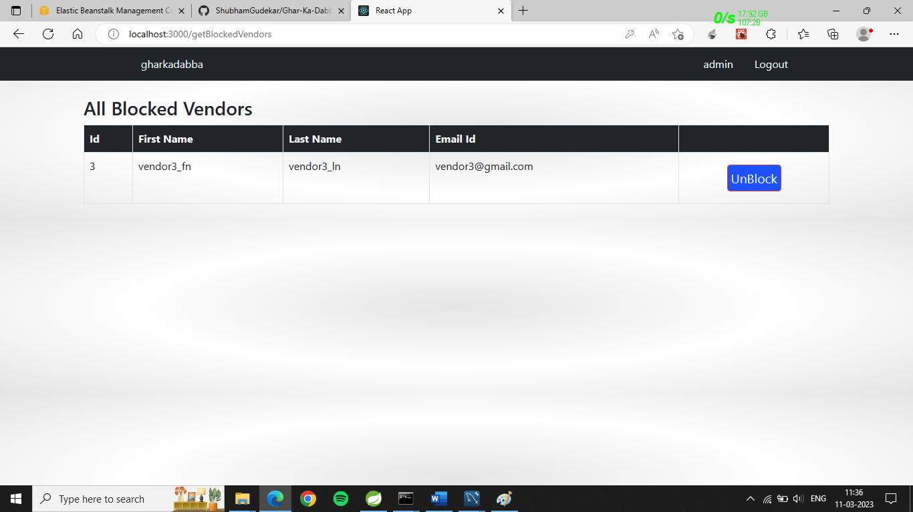
All blocked vendors on admin page

Slide 25
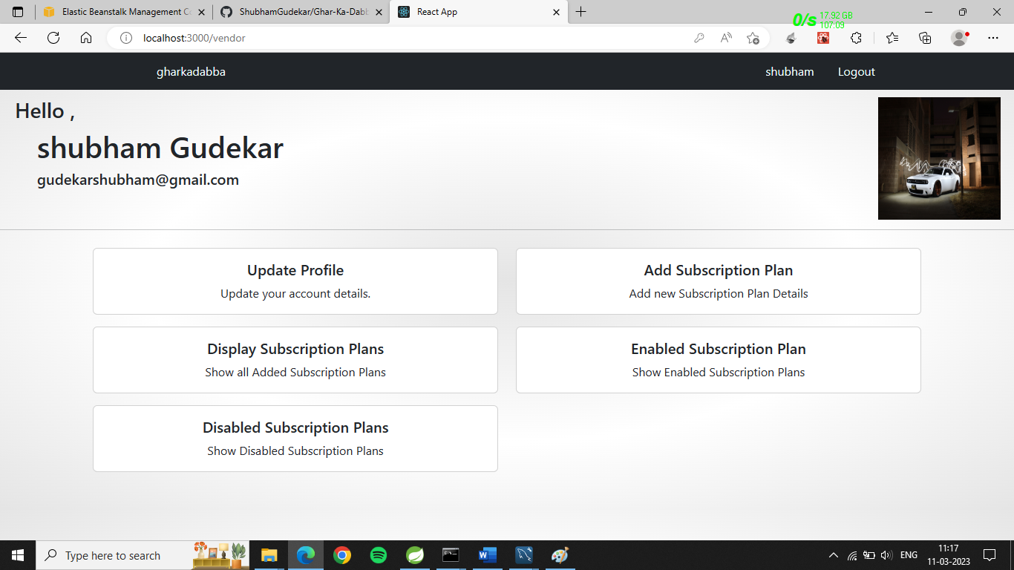
Vendor home page

Slide 26
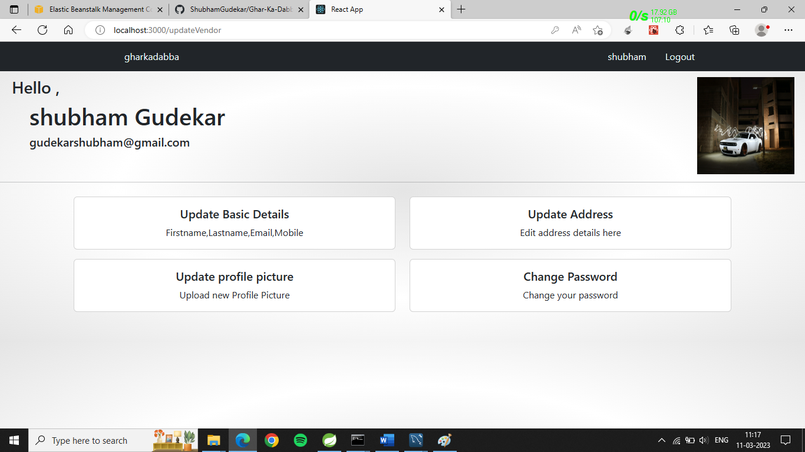
Vendor edit profile page

Slide 27
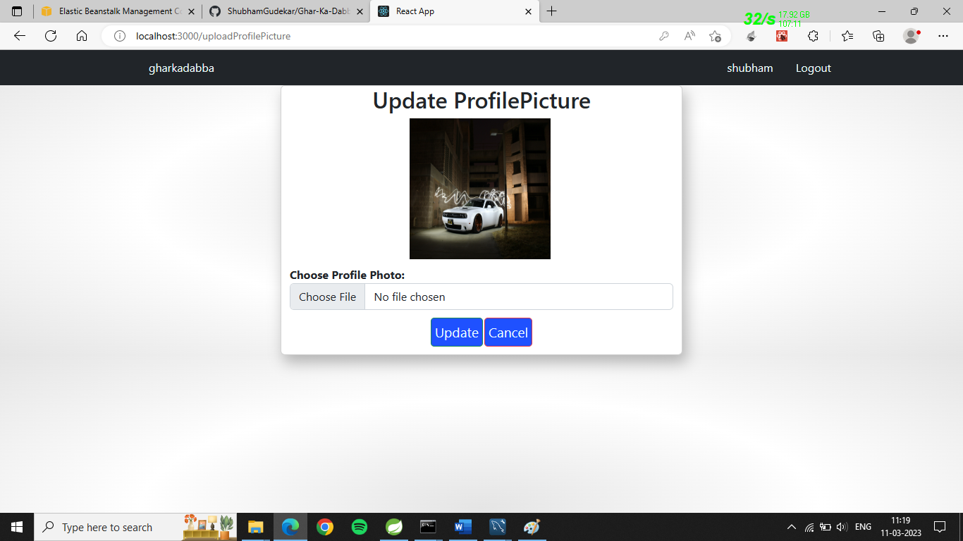
Vendor edit profile picture page

Slide 28
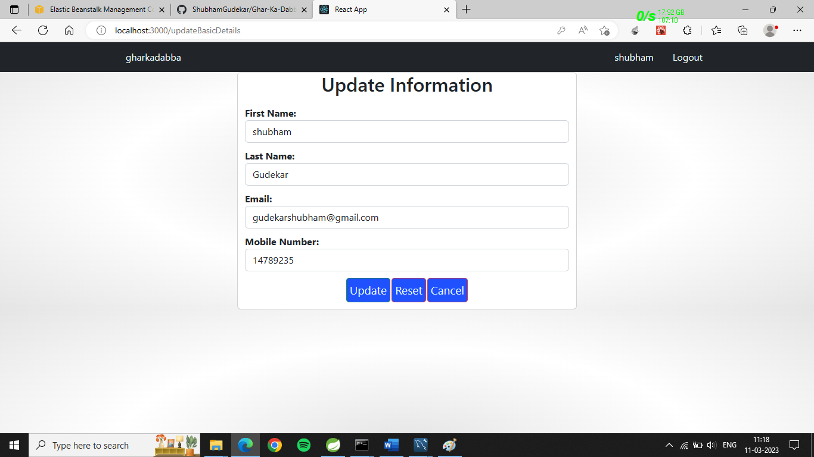
Vendor edit profile basic info

Slide 29
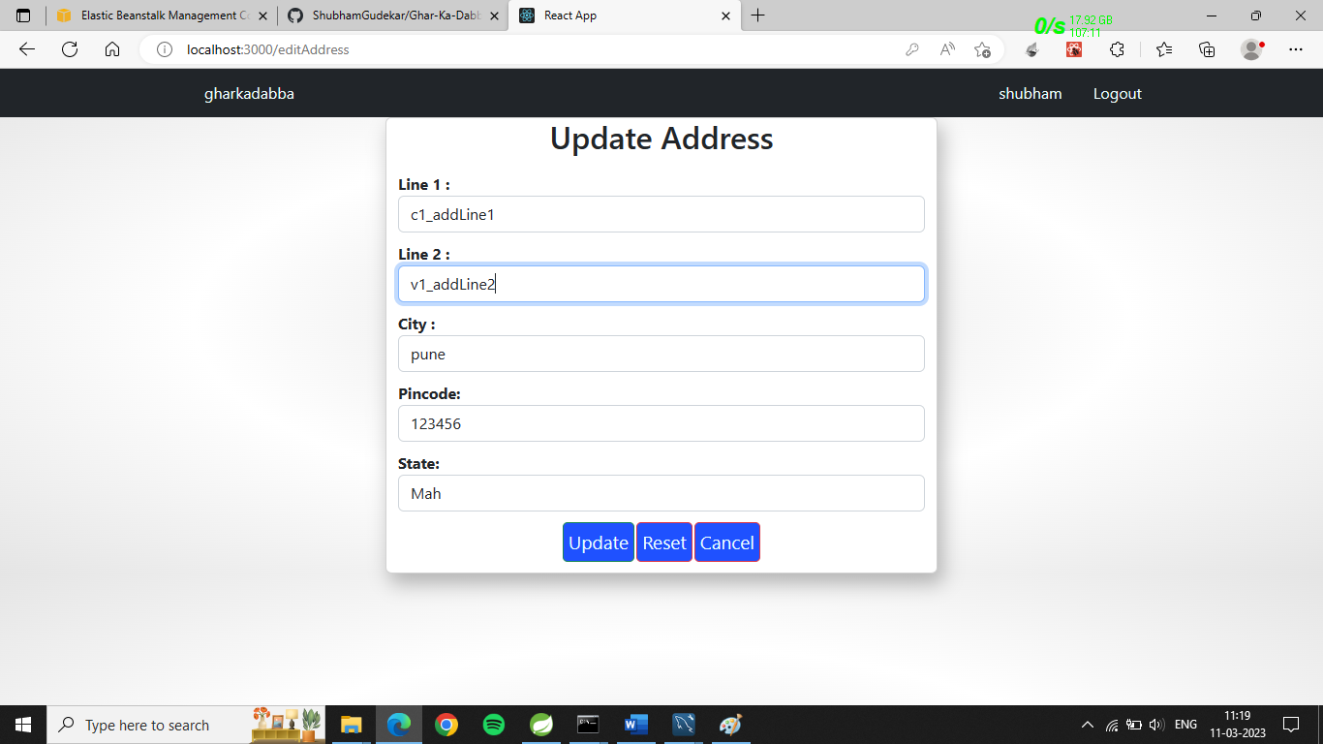
Vendor main page edit address

Slide 30
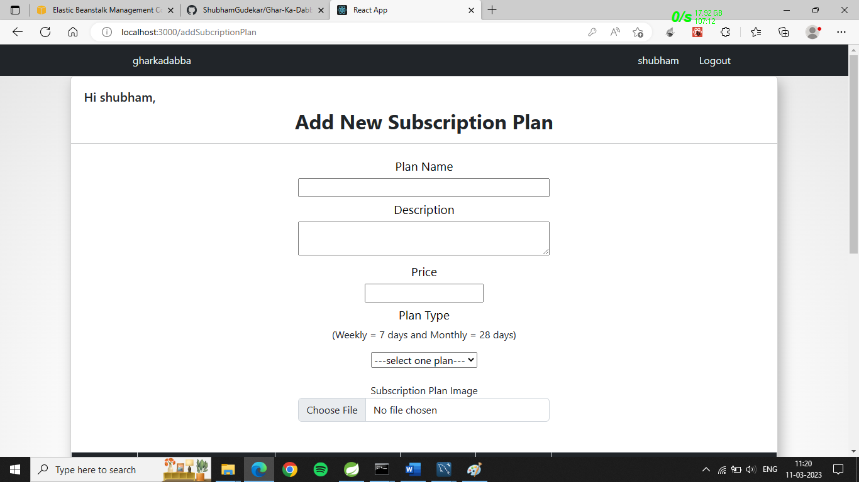
Vendor add new subscription plan page 1

Slide 31
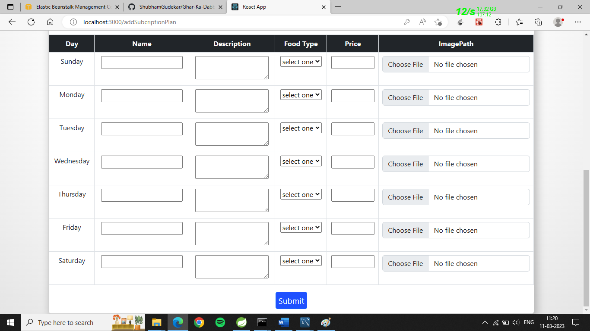
Vendor add new subscription plan page 2

Slide 32
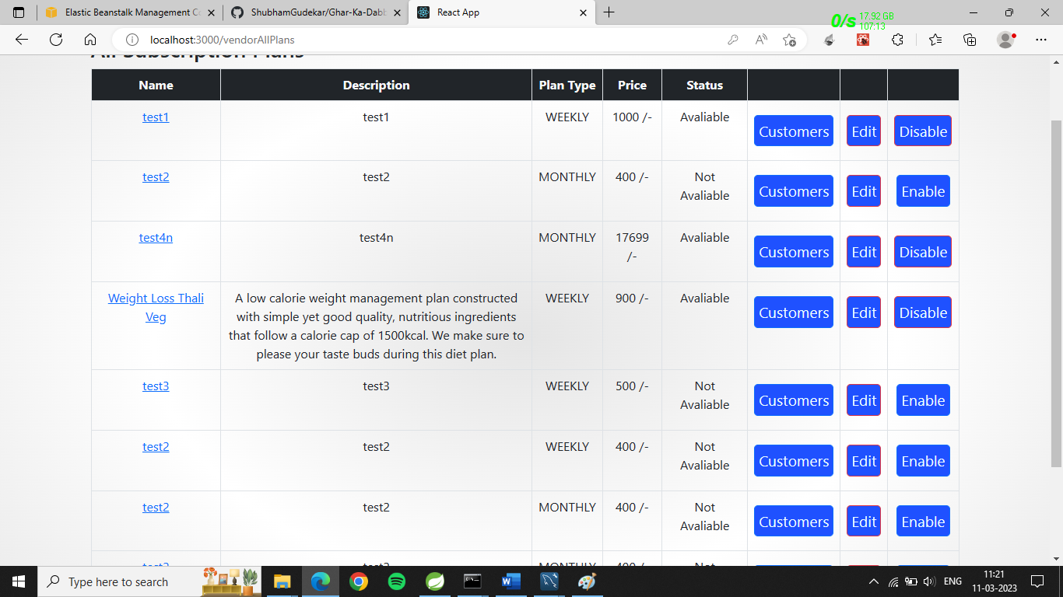
Vendor all subscription plans

Slide 33
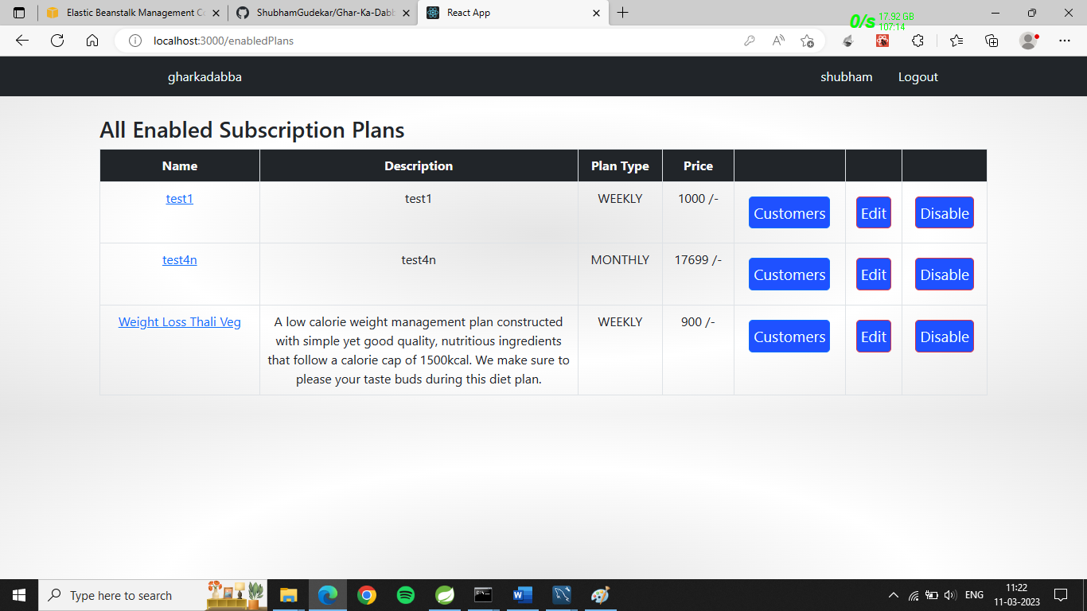
Vendor all available plans

Slide 34
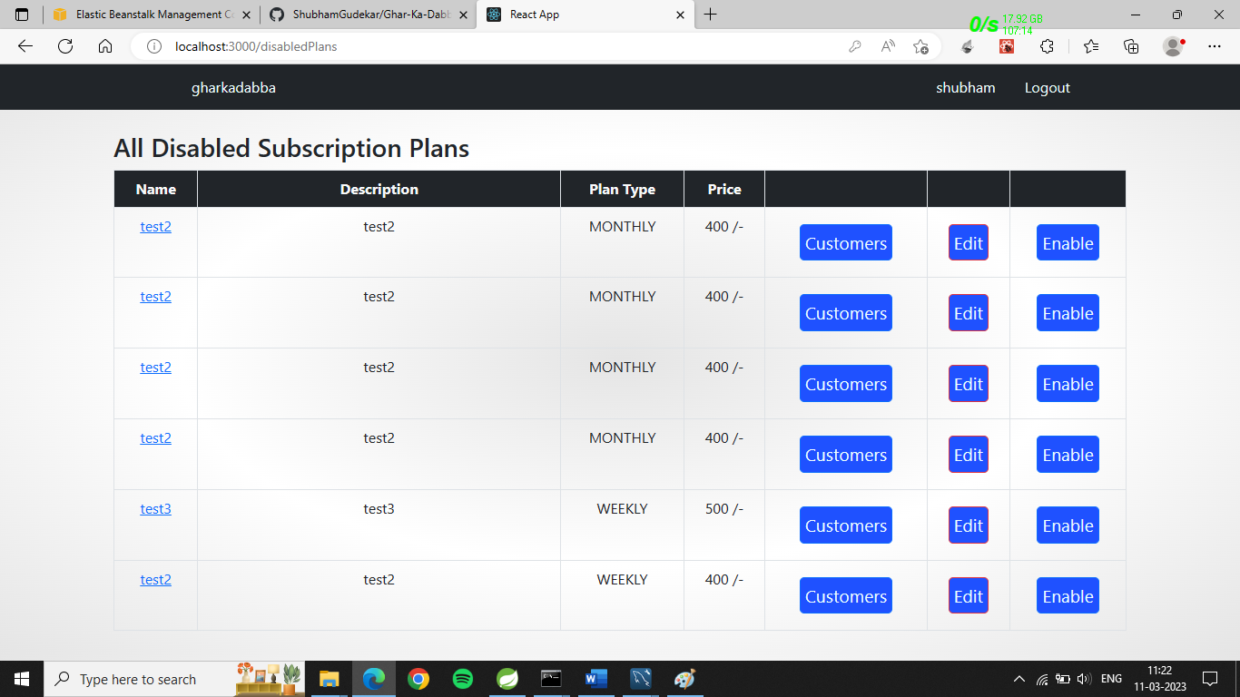
Vendor all disable plans

Slide 35
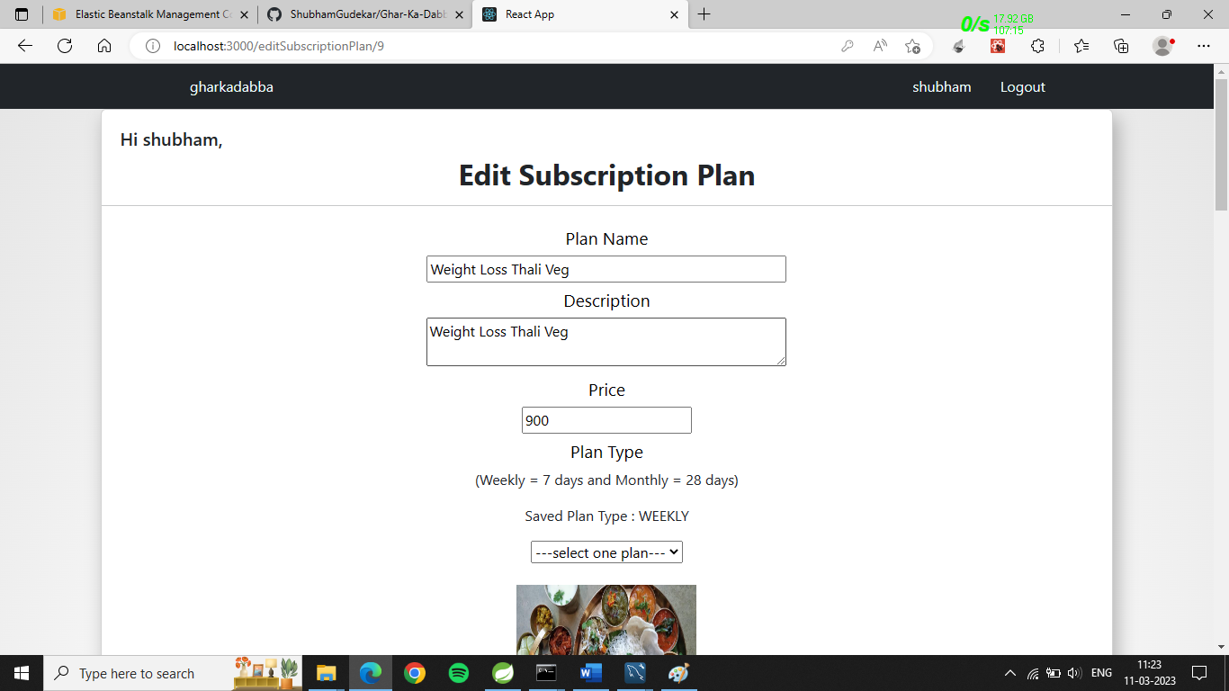
Edit subscription plans page 1

Slide 36
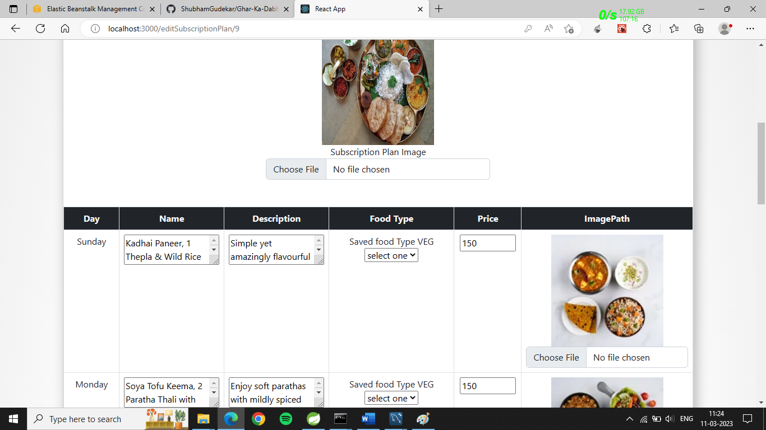
Edit subscription plans page 2

Slide 37
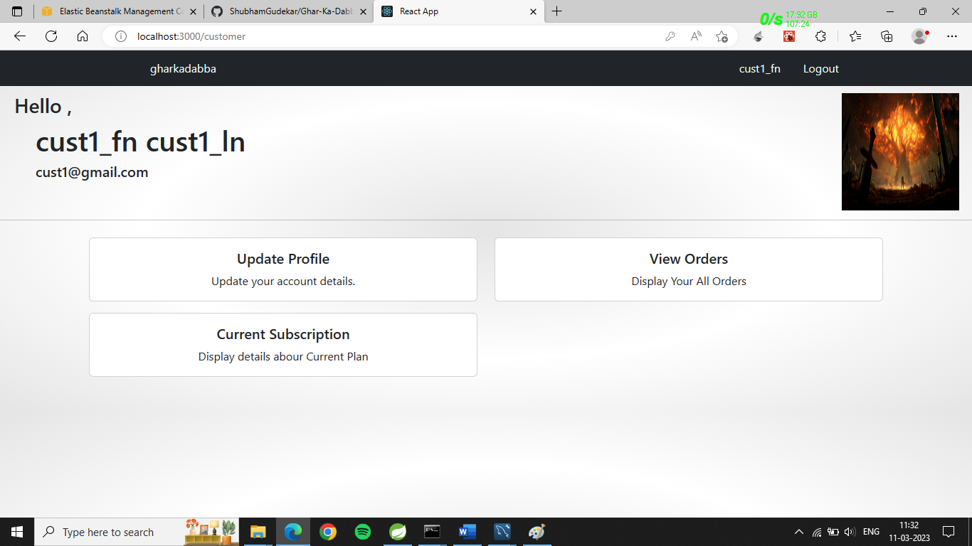
Customer home page

Slide 38
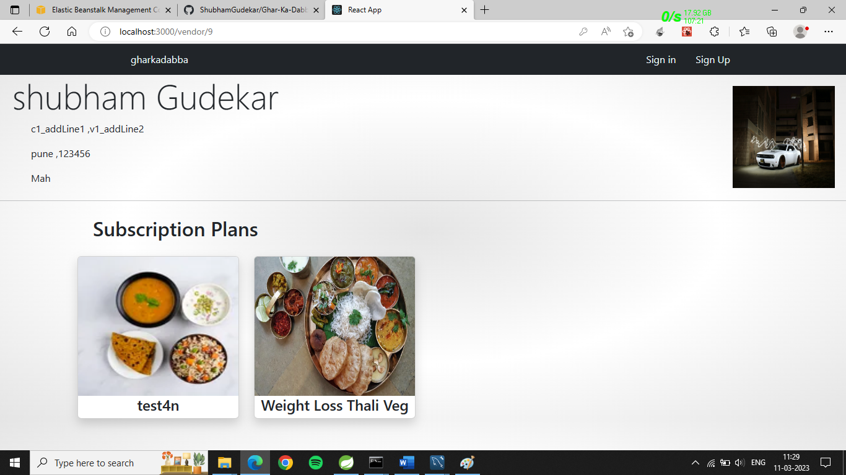
Customer page view for subscription plans

Slide 39
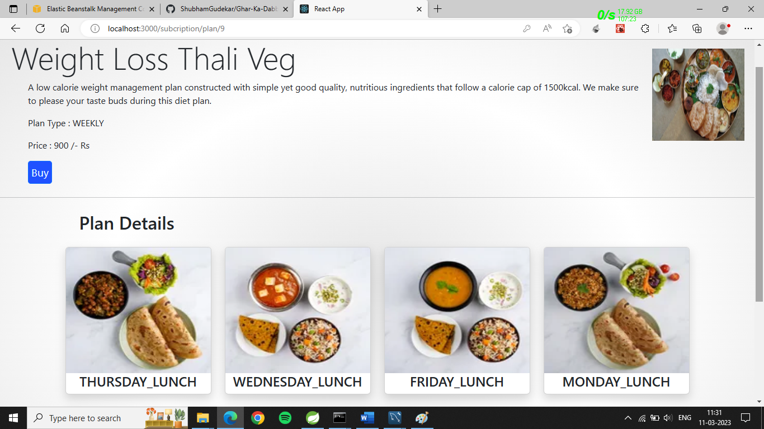
Customer page view for subscription plan’s tiffins

Slide 40
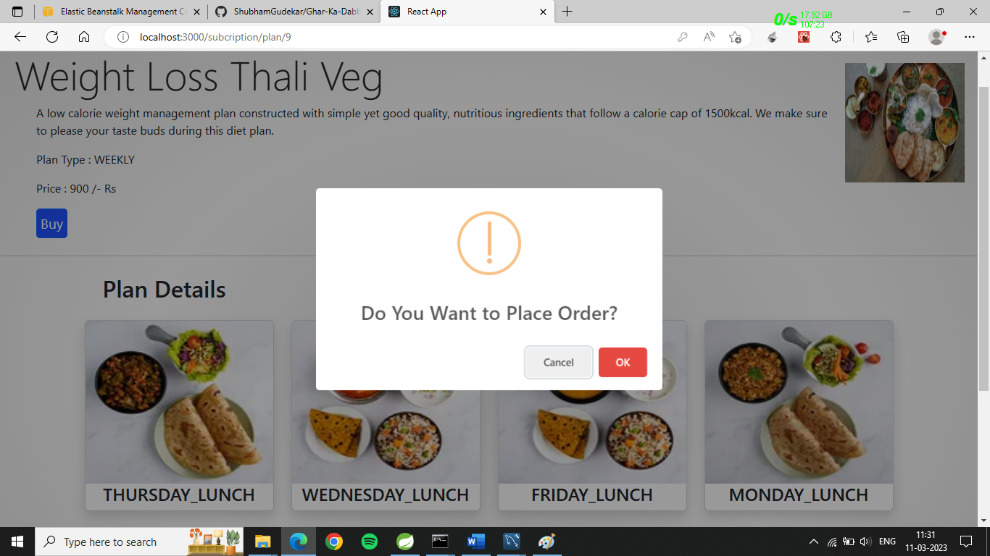
Customer page to place order

Slide 41
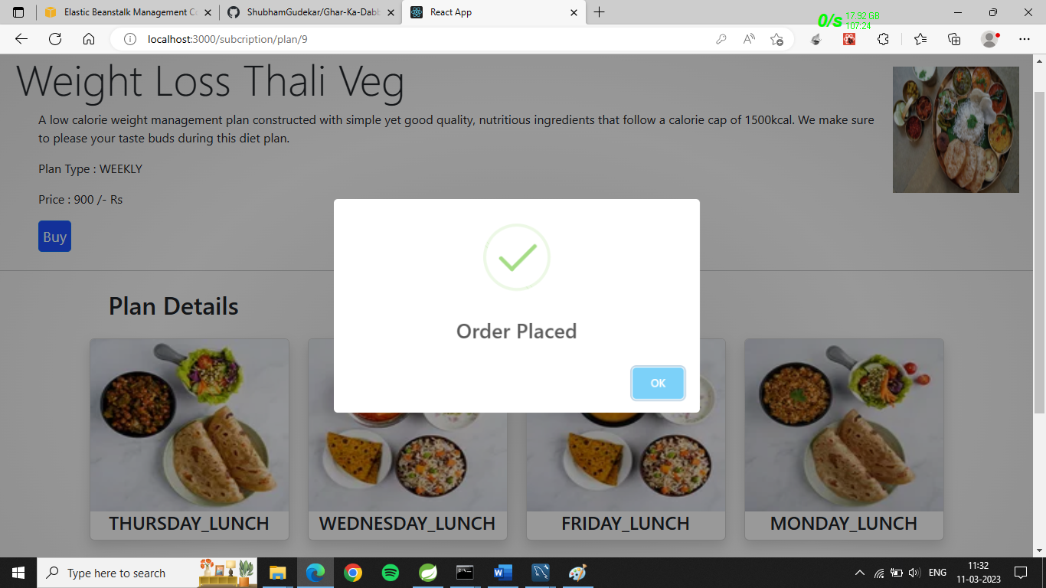
Customer page order placed successfully!

Slide 42
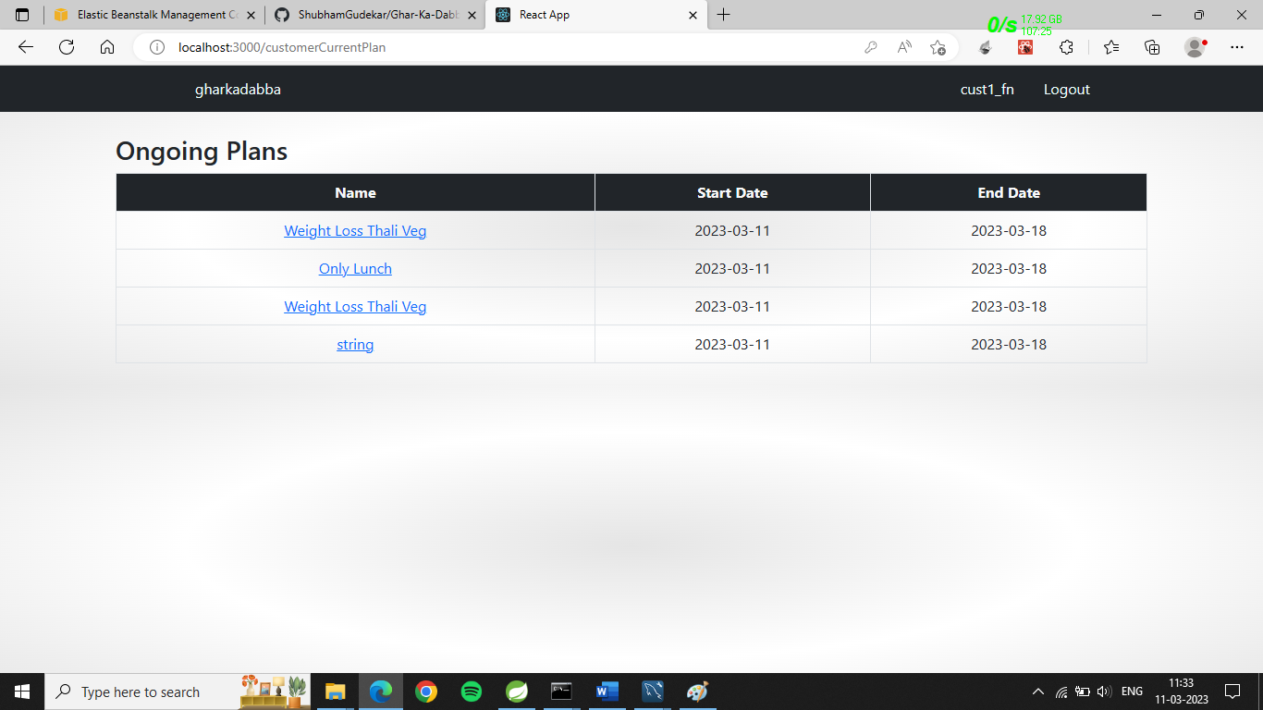
Customer ongoing plans page

Slide 43
Thank you

